Slide 1
Career Fair Prep
270 companies within walking distance of each other!
Source: ISU Engineering Career Services
+ What to do if you get an interview

Slide 2
Before the Career Fair
First and foremost, update your resume!
Be prepared to talk about all parts of your resume
If you can’t go into detail about what is on your resume, it shouldn’t be on your resume!
View list of companies at the Career Fair
http://www.engineering.iastate.edu/ecs/career-fair/
Search by major
Print off a map of where each company will be

Slide 3
Before the Career Fair
Apply Online for Internships and Interviews
https://ecms.eng.iastate.edu/students/
Two places:
ECMS – Iowa State’s job board where companies can post jobs and if qualified, interviews
The company’s own website – most companies require that you apply online for the position you want through the company’s own website

Slide 4
Before the Career Fair
Attend information sessions and workshops
Student panel – ask students who have had internships
Employer panel – ask employers looking for interns
Student workshops – various sessions put on by Engineering Career Services dealing with resumes, interviewing, etc. (some held after Career Fair as well)
http://www.engineering.iastate.edu/ecs/careerdevelopmentworkshops/
Attend networking sessions
Companies often come to campus several days early
Get to know a recruiter by name before the career fair

Slide 5
Before the Career Fair
Print your resume on thicker paper (generally called “resume paper”) so that your resume stands out when grouped with everyone else’s
Practice introduction
Name, major, current year & classification (if different)
What you are looking for (e.g. summer internship)
Highlight academics and extracurricular involvement
Ask if they would be interested in seeing resume

Slide 6
Before the Career Fair
Print off Career Fair map of Hilton/Scheman and the key showing which companies are where
Highlight locations (and write the names) of companies you want to visit on the map
Highlight corresponding companies on key and note the following:
Any connections (e.g. names of recruiters)
If you have applied online, if so, where (ECMS or company website) and for what positions
Map out route: least to most desirable company

Slide 7
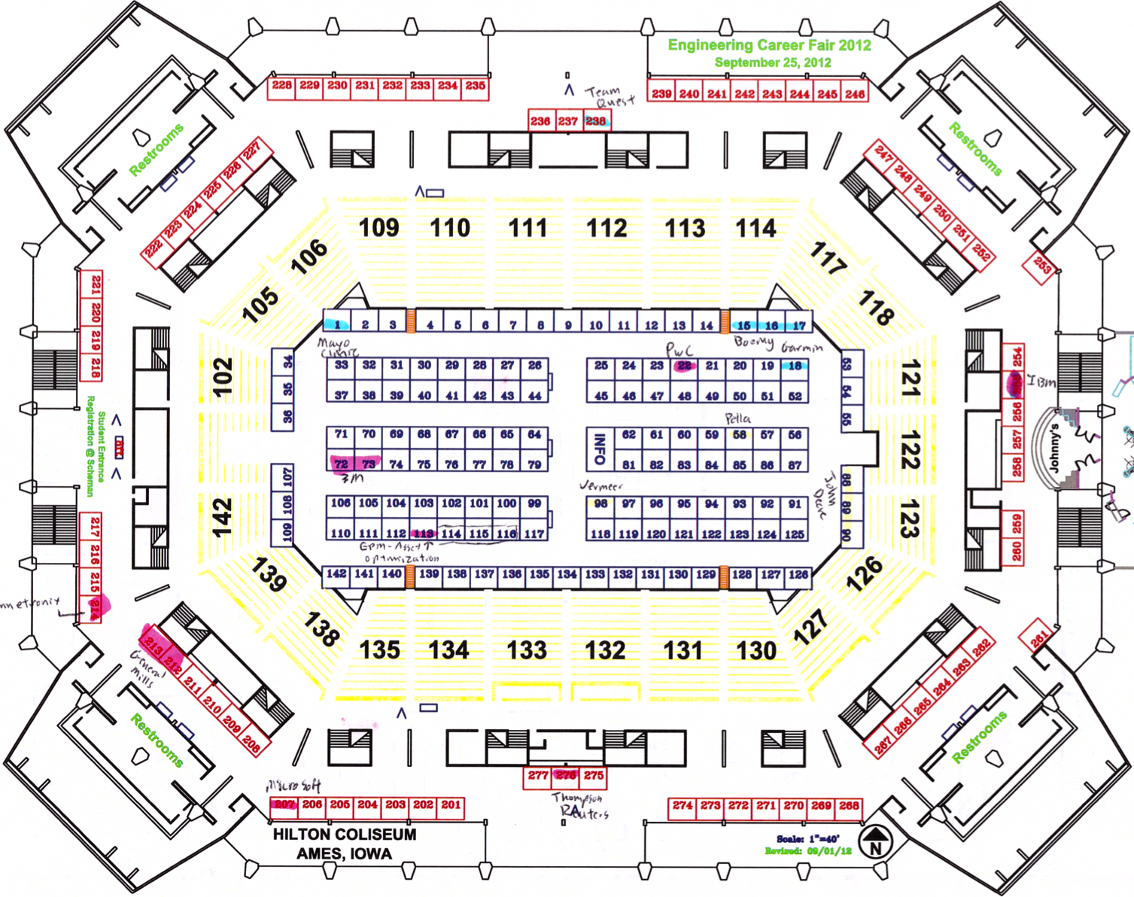
Before the Career Fair
MAP

Slide 8
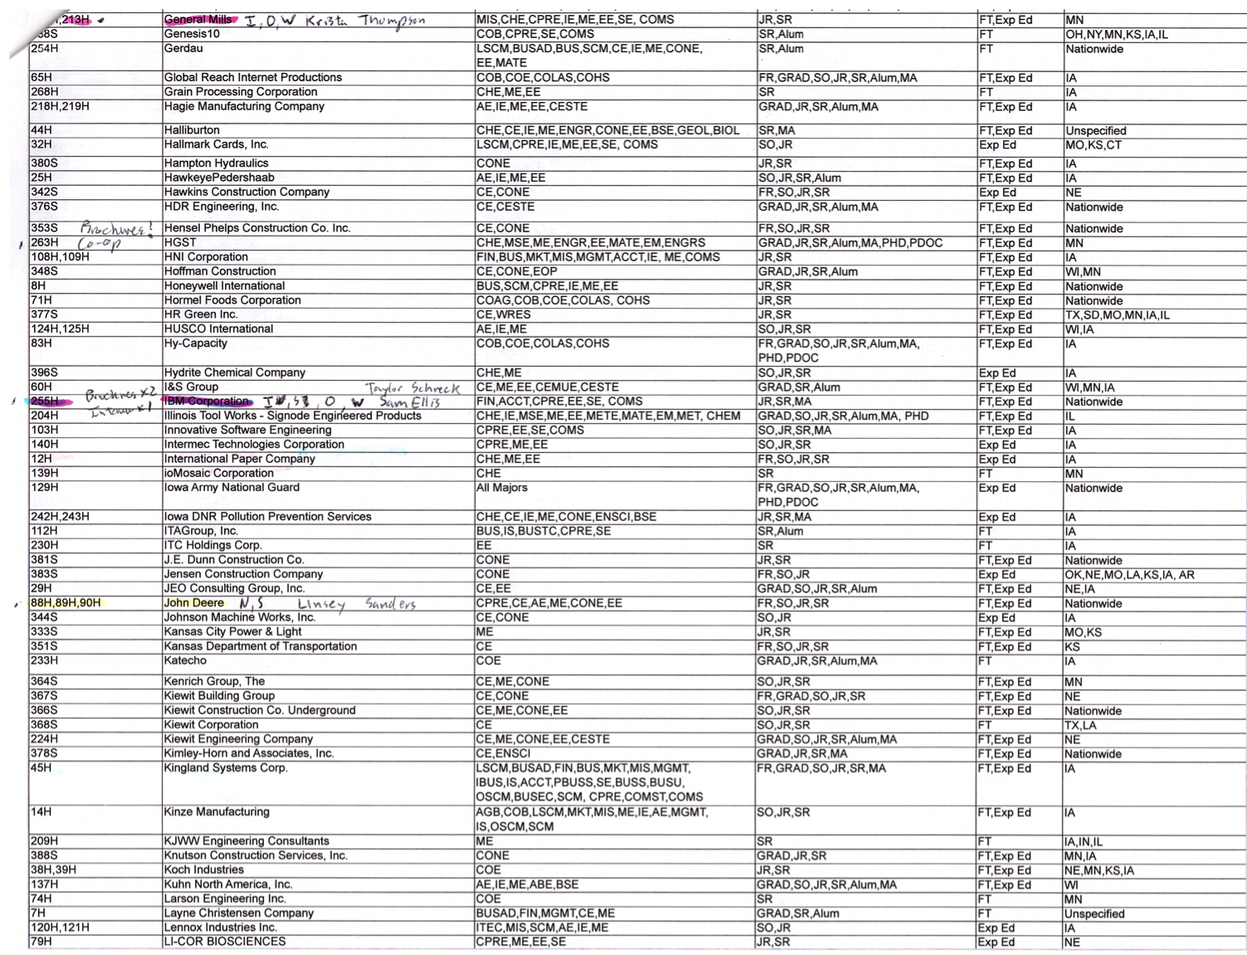
Before the Career Fair
KEY

Slide 9
Before the Career Fair
Do basic company research
You don’t have to go crazy and start memorizing the company’s core values and executive team just yet
Just have a general idea of what they do
How big is the company?
What is their market (e.g. medical, government)?
What is one product they make?
Where are they located? (already listed on key)

Slide 10
Before the Career Fair
Create a list of the companies you want to talk to on a sheet of paper
List the basic information for the company
Leave several blank lines to write in during the Career Fair
This will save you time during the career fair
Will also make sure you don’t get your companies confused

Slide 11
During the Career Fair
What to bring:
Your nicely dressed self (not going to explain)
Folio (professional notepad/folder)
Should have received one in your ENGR 101 class
Minimum 10 copies of your resume
Rule: resume for each company you want + 5 extras
Map and key (company list) of Career Fair
Two pens
Your schedule – many times you can sign up for interviews right at the employer’s booth during the fair

Slide 12
During the Career Fair
Start out by visiting companies you are least interested in for practice and slowly work your way up to the companies you most want to talk to
Once you locate a company’s booth, quickly review your notes for the company (e.g. basic information, if you applied online for a position)
Can do this while waiting in line to talk
Don’t neglect the smaller companies – less competition and usually smaller lines

Slide 13
During the Career Fair
After you talk to a company, step to the side and take a minute to debrief
Write down the name of who you talked with
Write down any notes, recommendations, or highlights from your conversation with the recruiter
What are your next steps with the company
Mark down if you received anything (brochure, pamphlet, etc.) so that you can review them later

Slide 14
After the Career Fair
Review notes from the Career Fair
Did you receive any pamphlets from the recruiters?
Any interviews?
What did the recruiter say to do next?
Apply online for any positions you haven’t already
Sit down, breathe, and relax!
Wait to hear back (hopefully)

Slide 15
You have an interview
Now what?

Slide 16
Before the Interview
Research the company
When established, location of headquarters
Number of employees, countries involved (if applicable)
Primary products
Positions available (for internship, co-op, etc.)
Note specifically what you like about the company
You may be asked why you are applying with them
Ex: interesting products (describe), good working environment, well known and respected company, etc.

Slide 17
Before the Interview
Come up with list of questions to ask the interviewer
Very important step – shows initiative on your part
Intern environment? (# of interns, work w/ full time?)
Work culture?
How will my work be evaluated and supervised?
Show interested in the interviewer!
What keeps you (the interviewer) coming back to work?

Slide 18
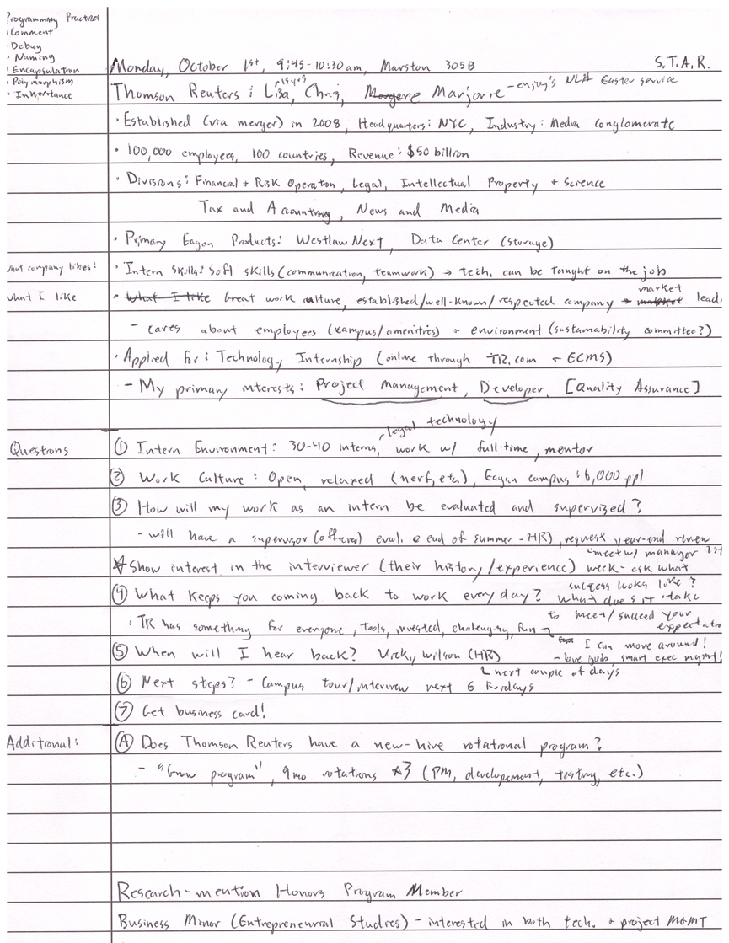
Personal notes
Company information
What I like about the company
What positions I applied for/interest
Questions
(w/ space to answer)
Room for additional notes
(can use back side)
Everything should be written down before the interview
except for what’s in the blue circle (answers to questions)
Closing comments to
mention during interview

Slide 19
Before the Interview
Practice and prepare interview question responses (Situation, Task, Action, Result = S.T.A.R. method)
Tell me about yourself
Why are you applying to this position/company?
What are your strengths and weaknesses
Describe a situation when you took prompt action
Give an example of a problem you recently solved
Recall a situation when you were not prepared for a task
Tell me about a time when you helped a team member or peer
*Know current trends in your field of engineering

Slide 20
During the Interview
What to bring:
Your nicely dressed self (not going to explain)
Folio (professional notepad/folder)
With companies notes and questions
Minimum 2 copies of your resume
Rule: resume for each interviewer + 1 for yourself to use
2 copies of your unofficial transcript (on AccessPlus)
Description/list of positions you have applied for
Two pens

Slide 21
During the Interview
Greet the interviewer by name (if possible)
Smile, firm handshake, eye contact
Don’t have to answer every question right away
Can take 5 seconds to compose your answer
Use your resume as your “cheat sheet”
Have it out so that you can look at it and use it to answer questions that the interviewer may ask

Slide 22
During the Interview
Closing out the interview
Ask the questions you have for the interviewer
Make sure the next steps are clear (ask otherwise)
When will I hear back?
From who? (the interviewer, HR, etc.)
What are the next steps?
E.g. apply online, just wait, etc.
GET BUSINESS CARD
At least have them write down their name and email

Slide 23
After the Interview
Follow up ASAP with a personal thank you email to each of the interviewers
Within 48 hours (sooner the better)
Thank for opportunity, tell about one thing you learned from the interview/interviewer
Remind them of 2-3 qualities of yourself
Review your interview notes and questions
What are the next steps?

Slide 24
Questions?

Slide 25
Practice, Practice, Practice
Can be hard to know when to do full introduction, etc.
Practice introduction (including handshake)
Name, major, current year & classification (if different)
What you are looking for (e.g. summer internship)
Highlight academics and extracurricular involvement
Ask if they would be interested in seeing resume
Ask each other to go into detail about different parts of their resume

