Slide 1
AIAA Resume Review
Please Check-in
(Specify if you're in ENGR 101)

Slide 2
Effective Resumes for Engineering Students + Q&A
Engineering Career Services
3200 Marston Hall ● 515-294-2540 ● ecs@iastate.edu ● www.engineering.iastate.edu/ecs

Slide 3
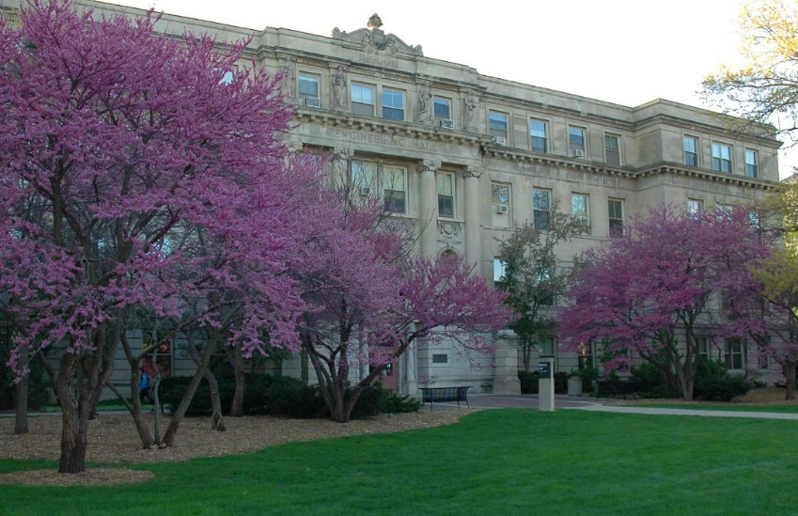
ECS is Here to Help YOU!
Our Goal:
Provide resources and opportunities to help engineering students develop professional skills and obtain post-graduate employment or acceptance into grad school upon graduation.
Staff focused solely on engineering students & alumni
Notes:
ECS is a team of 7 people. They…

Slide 4
Resume Best Practices
ECS advice is based on working with many engineering employers
Update it regularly – it is a dynamic view of you as a professional
Be honest but don’t undervalue yourself!
Typically one page for an undergrad
No standard format but should look professional and be consistent
Good format/layout examples in Canvas
Each section should be reverse chronological (add dates when applicable)
Proofread: Avoid spelling errors, typos and poor grammar
Use bullets instead of paragraphs
Keep it organized and easy to follow
Notes:
There are many ways to write/format resumes and even more opinions on what the “best” resume entails. All of the advice we provide is based on working with 1000s of engineering employers over many years.
-1st, you are constantly gaining new experiences and skills, so you should update your resume regularly. We recommend at least once/semester
-Be honest (do not make anything up), but also be sure that you are fully marketing yourself and your experiences so that employers understand your value
-Resumes for undergraduate students are typically only 1 page, but it you have a lot of relevant information to include, it’s ok to have a 2-page resume. Make sure that you do not have a lot of blank space if you go onto a 2nd page
-There is not a single format that should be used for a resume, but you should stay consistent. For example, if you right-align your dates in one section, you should do the same for all other sections including dates (many samples can be found on Canvas)
-Each section should also be in reverse chronological order. This means that you should start with your most recent experiences 1st and then work backwards in time.
-Even if writing is not a big part of what you will be doing in your position, making sure you have no errors shows that you have high attention to details which is important for all engineers! Have multiple people proofread your resume before submitting it.
-Recruiters typically do not take much time to look through a resume, so you want to make it as easy to read as possible. Using bullets instead of paragraphs is highly preferred by most recruiters.
-Another way to make it easy for recruiters to read your resume and create a good 1st impression is by being well organized.

Slide 5
Headers and Contact Information
Format - Doesn’t matter except for size
Name - Should be most prominent (CAPITALIZE and/or bold)
Phone and Email - Mandatory
Use professional voicemail and email address (e.g., first.last@gmail.com)
Address – City and state can be helpful in certain situations
Full street address not necessary and could be a safety consideration
DO NOT INCLUDE
Personal Information: Age, Gender, Marital Status, Photo, Etc.
EXAMPLE:
Theo Dolite
111-222-3333 | theodolite@iastate.edu
Ames, IA 50014
Notes:
First off, at the top of your resume is a header with your contact information.
*Remember that employers do not care too much about the overall formatting of your resume – just make sure it is consistent, polished, and professional
*The header includes your name which should stand out. You can do this by making it larger, bolded, or in a different font color.
*Your contact information should always include your e-mail and phone number. Make sure this information is accurate. If an employer can’t get a hold of you by one method, they may not try another. Also make sure that your voice message is updated (so they know who they’ve reached and is simple/professional). If you’re graduating soon, you’ll want to use a non-iastate.edu address as Iowa State deactivates email address the term after you graduate. You want to be sure employers can reach you! You can include your physical address if you choose to. If you are applying to positions in your hometown in can be beneficial to include your permanent address to show that you have a connection to the area.
*Do not include any personal information on your resume such as your birth date, age, gender, marital status, etc. You also should NOT include a photo of yourself.

Slide 6
Objective Statements (Recommended for College Students in a Career Fair Environment)
OK to be generic but give timeline and major.
Ex: To obtain an internship in [major] starting in the summer of [year].
For a longer internship: To obtain engineering internship experience during [year] working as a [major].
Notes:
Emphasize that tailoring objective statement is preferred (especially if applying online)

Slide 7
Education
Usually what employers want to see first, so it should be immediately after objective statement.
List most recent first (i.e., college, community college, high school).
As you run out of space, you can remove high school experiences
EXAMPLE:
Iowa State University, Ames, IA
Bachelor of Science in [Major]
Expected graduation date: [MONTH YEAR]
GPA: 3.45/4.00
Notes:
The education section comes after the objective statement and is a very important part of your college resume.
-Starting in this section you will also begin listing items in reverse chronological order meaning that the most recent experience is listed first. So, your Iowa State information will be listed first, and then any other collegiate institutions, or high school information next.
-For Iowa State you want to list out your degree level, your major, your cumulative GPA and your anticipated graduation date.

Slide 8
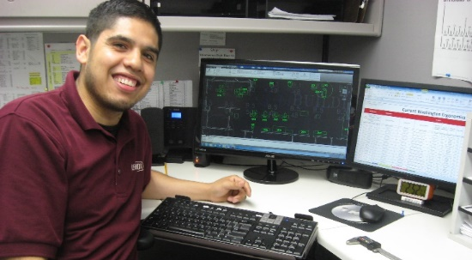
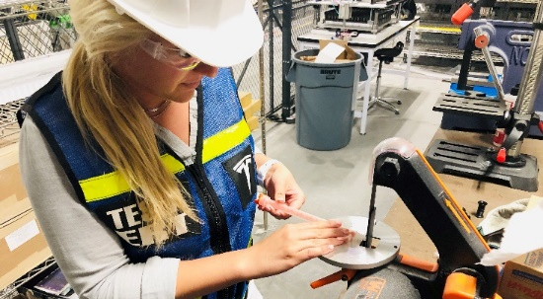
Work Experience Section(s)
Can include:
Professional (co-ops/internships, research, military)
Other paid positions (Server, Retail, Labor, etc.)
You can list experiences in separate sections to emphasize your professional experiences
“Professional Work Experience” and “Other Work Experience”
It is critical to include bullet statements to highlight transferable skills, level of responsibility, accomplishments, etc.
Notes:
The next part of your resume is devoted to work experiences.
*This includes any experiences that you are paid for. Employers highly value the skills you gain in work experiences, whether those are professional skills or technical skills
*You can choose to list your work experiences in two different sections if applicable: Professional Work Experience and Other Work Experience. This can help to ensure that your professional experiences are emphasized toward the top of your resume.
*One of the most important parts of your resume is the bulleted statements describing the details of your job. These are used to share your skills, responsibilities, and accomplishments, and show employers that you have successfully held a job in the past. While employers may be interested in the specific tasks you completed while in your position, they are more interested in seeing the skills you developed. We’ll spend some time helping you learn how to build effective statements later in this video!

Slide 9
Work Experience Example: Only “Other” Work
Notes:
Now let’s take a look at a few different ways to format your work experience. Here is an example of how to show your work if you only have non-engineering experience at this point.

Slide 10
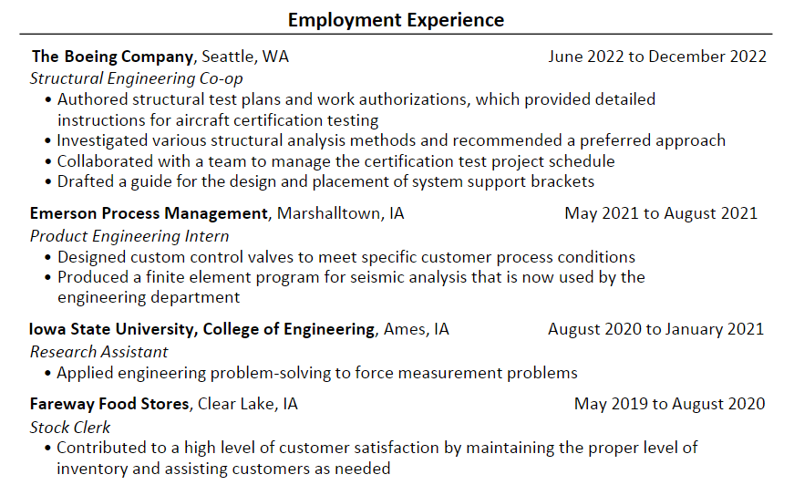
Work Experience Example: “Professional” & “Other” Combined
Notes:
Here is an example of how to show both professional and non-engineering work experiences combined in one section called ‘Employment Experience’. Note that more bullets are included for the professional co-op/internship positions compared to the part-time research and stock clerk positions.

Slide 11
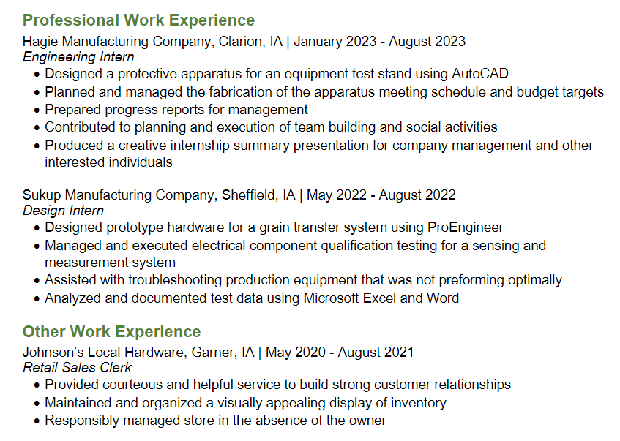
Work Experience Example: “Professional” & “Other” Separated
Professional Work Experience appears first because it’s more relevant, even though work at Johnson’s Local Hardware is more current
Still emphasizes important skills but appears below professional experience
Notes:
Finally, here is an example of how to separate your professional and non-engineering work experiences into two different sections. Remember that you want to emphasize your professional experiences as much as possible, so you want to list them first and dedicate more space to them.

Slide 12
Developing Skills-Based, Impact Statements
Identify a task that was performed
Prepared test specimens.
Checked out customers.
Identify a transferable skill used to complete the task
Followed a detailed procedure to prepare test specimens. or
Provided excellent service while accurately and efficiently checking out customers.
Add the Impact (if known)
Followed a detailed procedure to prepare test specimens that consistently met quality standards.
or
Provided excellent service while accurately and efficiently checking out customers to decrease overall wait time.
Anyone can say that they have certain skills, so employers look for proof that you have had experience and success applying certain skills.
Notes:
There is a 3-step process for writing skills-based impact statements and I’ll walk you through 2 different examples of this process.
*First, you start by identifying a task that you performed at your job. The 1st example is an undergraduate research assistant whose task was to “Prepare test specimens” for an experiment of some sort. The 2nd example is a student working at a retail position with the task of checking out customers.
*Again, most engineering employers want to see more than just the task – they want to see a transferrable skill applicable to their work environment. Therefore, the 2nd step is to expand our task to include a transferrable skill such as “Following detailed procedures” or “providing excellent customer service”. You might remember from our last video that Quality Orientation and Customer Focus are two of the top skills that employers look for in engineers, so these are excellent ways of showing that you can successfully use those skills.
*Lastly, recruiters also appreciate seeing the scope, magnitude, and impact of your work. So for the final step, we want to take our statements and add in the impact or outcome. For example, maybe you “consistently met quality standards” or “decreased overall wait time”.
*Whenever possible, try to tailor your bullets to the position you are applying to. For example, if a position description states that they want someone with excellent communication skills, you could write a bullet describing how you communicated with customers in order to provide them with a great experience.
Following this process for each of your bullets will help you build an effective resume!
While this process may take a little bit of time when you are initially building your resume, it is extremely important, as employers want to see proof that you have actually used your skills, rather than just seeing them listed out.

Slide 13
Activities/Leadership Section
Many employers look for involvement outside of coursework
Format similar to work experience
Highlight teamwork, leadership & project management where possible in bullets
EXAMPLE:
Notes:
Employers want to see students take initiative to learn new things and get involved in activities outside of their classes. Specifically, they want to see students take on teamwork, leadership, and project management roles. These roles should be expanded upon if possible and written similar to work experiences. Use a format consistent with work experiences by listing your title, dates involved, and bulleted skills-based work impact statements. Engineering clubs and competitions carry more prestige to employers than non-engineering activities, but all can add value to your resume if you use them to emphasize your skills and qualifications. This section is where you would also list memberships in professional societies.
Several different titles can be used for this section, depending on what you include. Examples include Leadership & Activities, Extracurricular Activities, Volunteering, and Involvement

Slide 14
Skills Section
Skills: Include if relevant to position (ok to just list unless certified)
Computer software (MATLAB, MS Excel)
Foreign (Spanish) & computer languages (C, FORTRAN, JAVA)
Technical skills (small engine repair, welding, metal fab)
EXAMPLE:
**NOTE: Soft skills (teamwork, communication, etc.) are not included in the skills section. Emphasize these through your experiences and involvement.
Notes:
*The skills section is very important for an engineer because it often shows the variety of ??tools/programs/skills?? that you have begun to learn and use. Everyone has different skills, so there is no mandatory checklist of skills that must be in this section. Often this section will include: computer skills & software programs, computer & foreign languages, and technical skills you may have learned through various experiences. It is OK to re-list a skill or tool here even if you referenced it in one of your work impact statements in another section. If you have at least used a tool or skill at beginner level then go ahead and list it on your resume. It is not required that you qualify your level of experience unless you’ve received a certification.
*This section should focus on your relevant engineering and technical skills and should not include professional skills such as teamwork and communication. These types of skills should instead be included within the context of your other experiences.

Slide 15
Other Potential Sections: Projects, Honors/Awards
Projects: Can be helpful for those with little or no professional work experience. Treat them like work experience and add bullets
Can include relevant class, student org, or personal projects
Honors/Awards: Include if you have room, but it is optional
Scholarships and Dean’s List recognition are not very important to employers
Focus on awards that show your positive character traits, contributions, or skills
Notes:
Now I want to mention a few optional sections that you can include in your resume.
*One optional section is project, which can be particularly helpful if you have no professional work experience. Projects are a great way to emphasize some of the technical and project management skills you have gained. You can include any relevant projects that you’ve done in class, as part of a student organization, or on your personal time. Treat them just like a work experience with skills-based impact statements.
*An Awards and Honors section is optional because employers tend to value your other experiences more. Also, many awards are based on GPA which they will already be able to see in your Education section. However, you can include this section if you have room or you have some prestigious and unique academic achievements.

Slide 16
Steps to Tailor Your Resume
Review the job description and any other information you have about the position/company.
Make note of the skills/character traits/qualifications they are seeking
Make edits and/or additions to your application materials to emphasize your relevant experiences
Notes:
Tailoring your application materials to a certain position might sound daunting, but it is actually fairly easy and doesn’t mean you have to completely re-write your resume for every job application. Just follow these 3 simple steps:
First, review any information you have collected about the position and company; paying particular attention to the job description.
As you are reviewing these materials, make note of any skills, character traits, or qualifications that are mentioned. These are going to be the things the employer is looking for on your application
Lastly, make edits and/or additions to your application materials to emphasize your relevant experiences that demonstrates those skills, traits, and qualifications. These edits can be made to your resume, cover letter, answers to supplemental questions, or any other piece of the application.

Slide 17
Questions?
Remember, you can schedule a career advising appointment through CyHire if you want to meet individually with an advisor.
Engineering Career Services
3200 Marston Hall ● 515-294-2540 ● ecs@iastate.edu ● www.engineering.iastate.edu/ecs

Slide 18
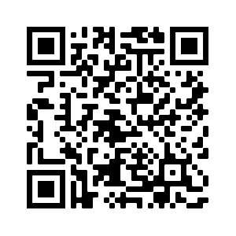
Thank You for Attending!!!
Please take a few minutes to fill out our survey.
Full schedule of upcoming career seminars available on ECS website!
Follow us on Instagram @isu_ecs
Engineering Career Services
3200 Marston Hall ● 515-294-2540 ● ecs@iastate.edu ● www.engineering.iastate.edu/ecs

