Slide 1
Hypersonic Flight With
Rocket Power and Air
Breathing Propulsion
Presented to
Iowa State University
Aerospace Engineering Department
October 17, 2013
Ames, Iowa
Ming Tang
President
High Speed Technology Venture
Williamsburg, VA
Notes:
Booz Allen Hamilton Standard Colors
Colors should be used in the color pairs whenever possible. Do not mix and match colors, use pairs together as shown.
Black, White and Gray can be used with any of the other colors.
Purple Pantone 2765
R 12
G 4
B 79
Green Pantone 357
R 15
G 67
B 24
Blue Pantone 2 88
R 11
G 31
B 101
Black
Pantone Cool Gray 6
R 158
G 158
B 158
Red Pantone 485
R 252
G 5
B 14
Yellow Pantone 3965
R 232
G 244
B 4
Aqua Pantone 319
R 126
G 204
B 189
White

Slide 2
Content
Hypersonic Domain
Rocket Power
Air Breathing
Air Breather Examples
Reusable Air Breather
Concluding Remarks

Slide 3
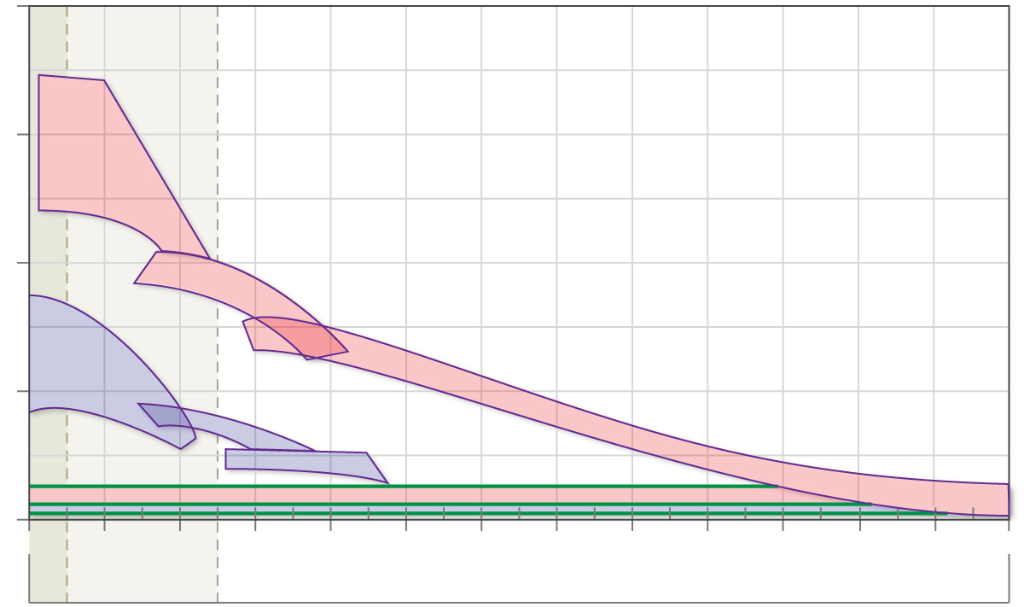
Air-Breathing and Rocket Propulsion Options
8000
Hydrogen Fuel
Cryogenic storage
Larger volume
Easier ignition
Air Breathing Propulsion
6000
Turbojets
Hydrocarbon Fuel
Easier to handle
Smaller volume
Harder to ignite
Rocket
Propulsion
Ramjets
X-43A
I
4000
sp
Specific
Impulse
(seconds)
Turbojets
Scramjets
2000
Ramjets
Scramjets
ASALM
Rockets
0
0
2
4
6
8
10
12
14
16
18
20
22
24
26
SUBSONIC
Mach Number
SUPERSONIC
HYPERSONIC

Slide 4
Content
Hypersonic Domain
Rocket Power
Air Breathing
Air Breather Examples
Reusable Air Breather
Concluding Remarks

Slide 5
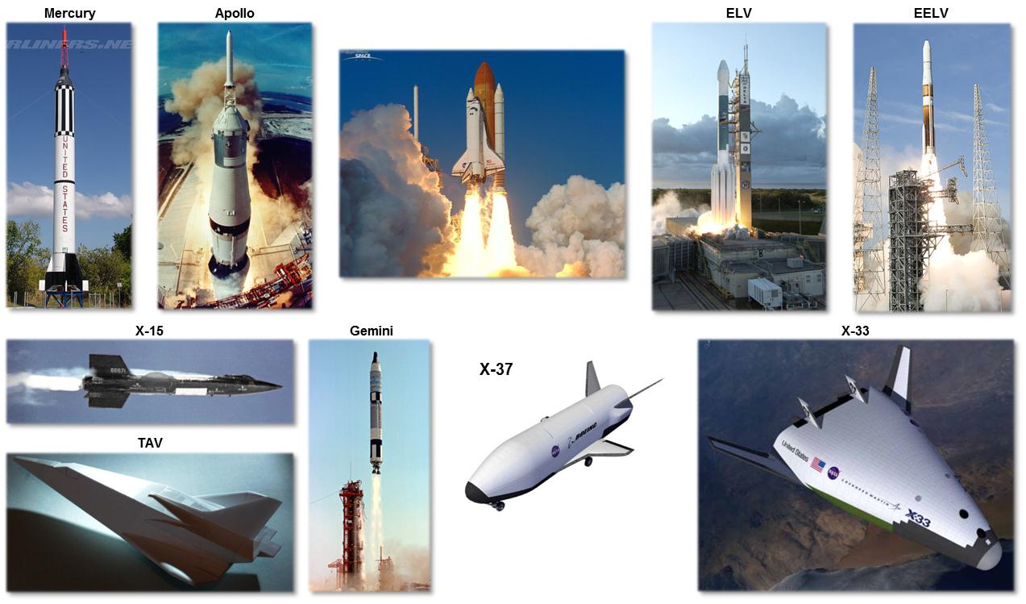
Rocket Propulsion Vehicles

Slide 6
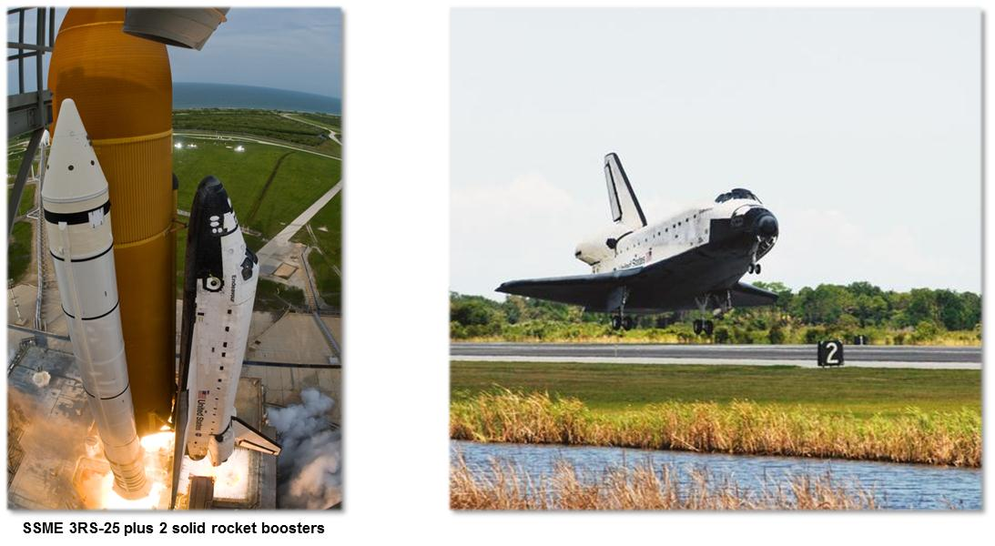
Boost Glide Space Shuttle

Slide 7
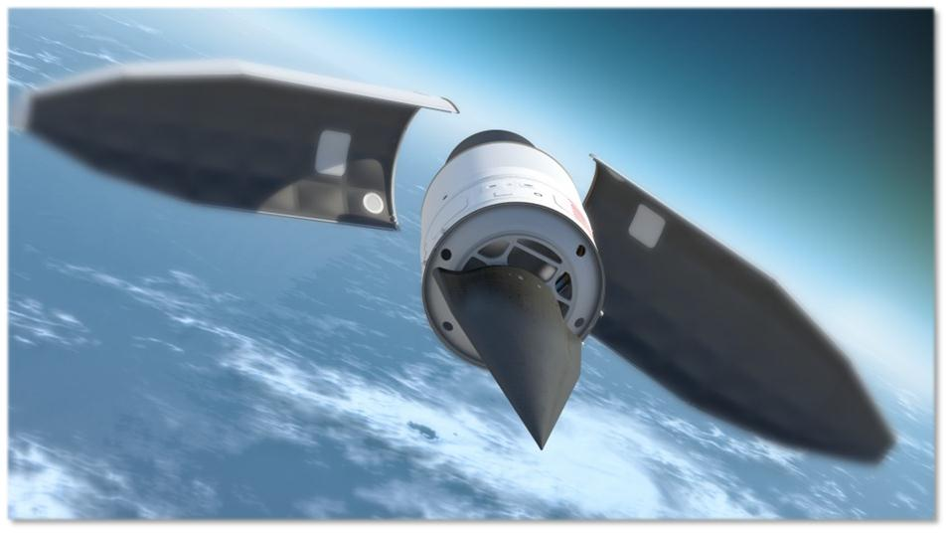
Falcon HTV-2
SSME 3RS-25 Plus 2 Solid Rocket Boosters

Slide 8
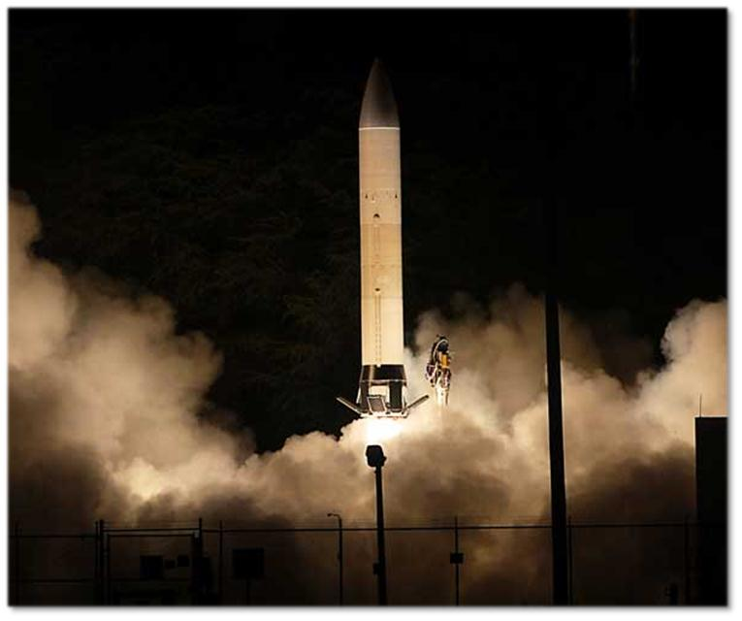
Advanced Hypersonic Weapon (AHW)
Strategic Target System (STARS)

Slide 9
Content
Hypersonic Domain
Rocket Power
Air Breathing
Air Breather Examples
Reusable Air Breather
Concluding Remarks

Slide 10
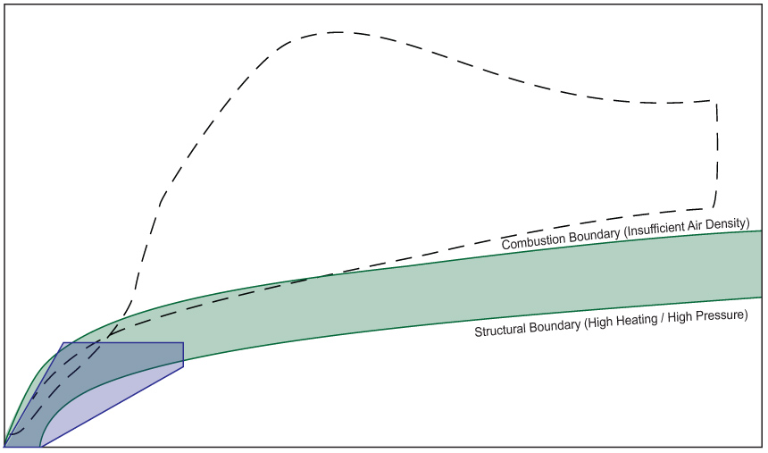
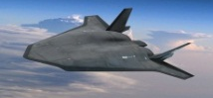
Falcon HTV-3X is not NASP
450
400
Blackswift
350
Shuttle
Ascent
300
Descent
250
Attitude (kft)
NASP
200
Air-Breathing Vehicle Corridor
150
100
50
Blackswift
0
0
2
4
6
8
10
12
14
16
18
20
22
24
26
Flight Velocity (kft/sec) or Approx Mach Number

Slide 11
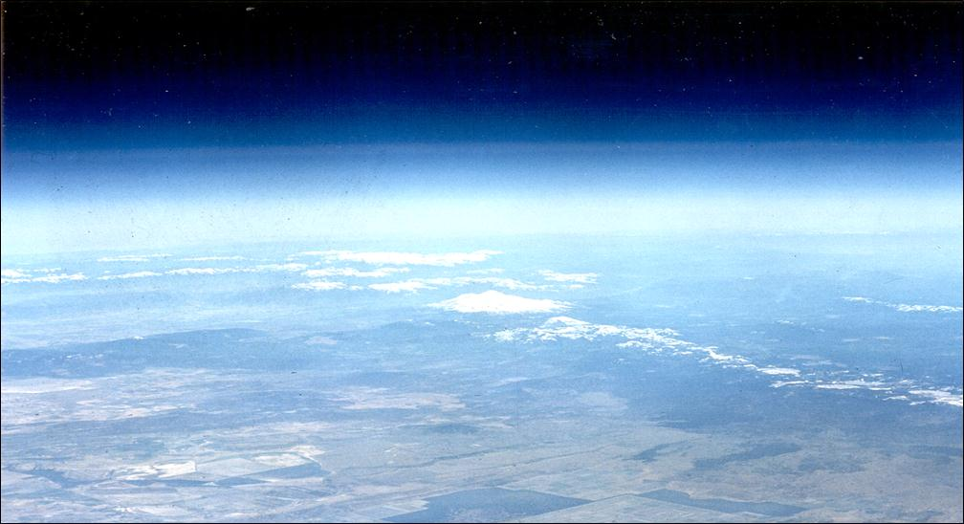
Hypersonic / Air Breathing Propulsion Programs
Ramjet
Scramjet
Flight
X-43A
Hyper-X
X-51
SED
ASALM
Aerospace
National Aerospace
National Aerospace
Plane
Plane (NASP)
Initiative (NAI)
Studies and Ground Tests
ARRMD
FALCON
Blackswift
HRE
X-24C
NHRF
HST
RCCFD
X-43B
X-43C
X-43D
HYFLITE-III
HyFly
DCR
1960
1970
1980
1990
2000
2010
Calendar Year

Slide 12
Content
Hypersonic Domain
Rocket Power
Air Breathing
Air Breather Examples
Reusable Air Breather
Concluding Remarks

Slide 13
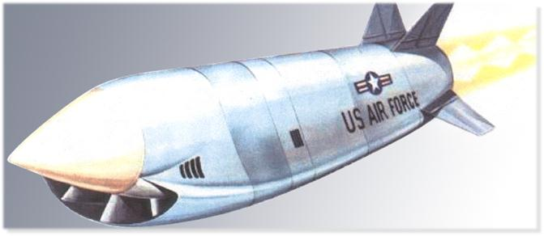
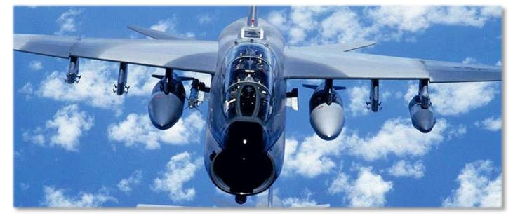
ASALM
Integrated Rocket/Ramjet Propulsion
Solid fuel rocket casing when burned out
Served as combustion chamber for RAMJET
Seven Successful Flights
Mach 4.5 -5.5
.300 miles range
ASALM
A-7 Corsair

Slide 14
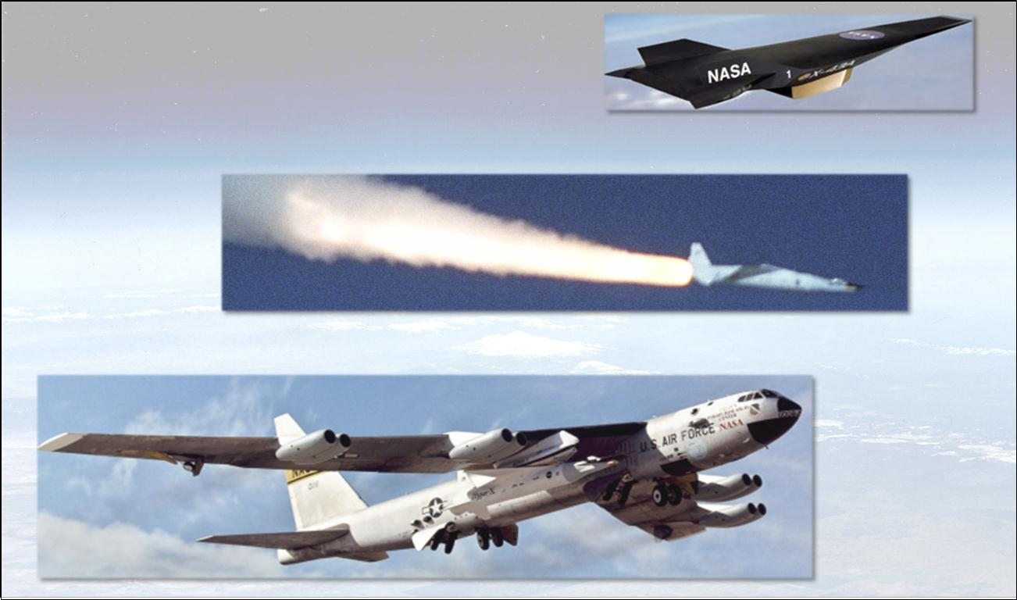
X-43-A

Slide 15
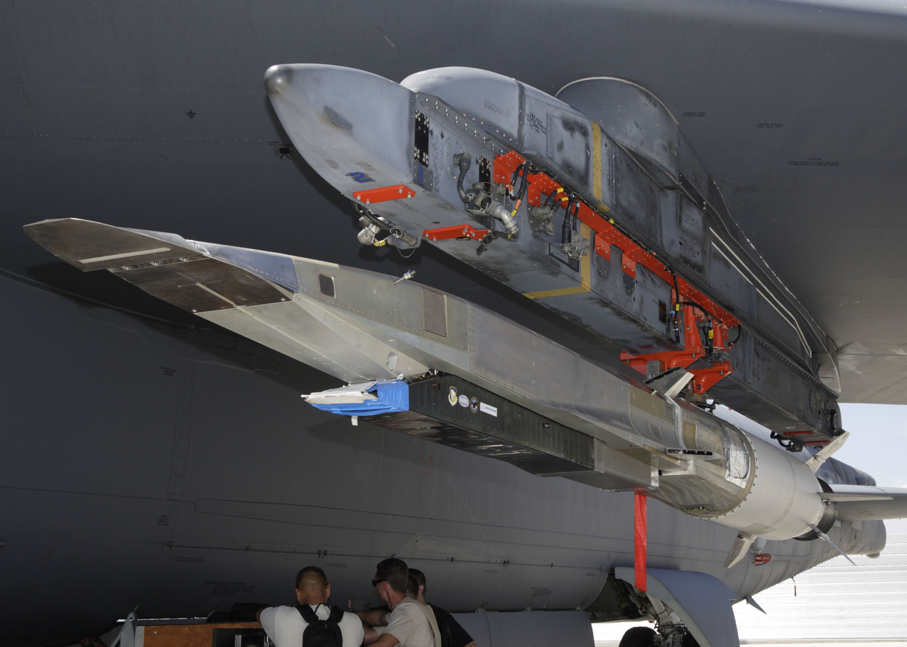
X-51a

Slide 16
Content
Hypersonic Domain
Rocket Power
Air Breathing
Air Breather Examples
Reusable Air Breather
Concluding Remarks

Slide 17
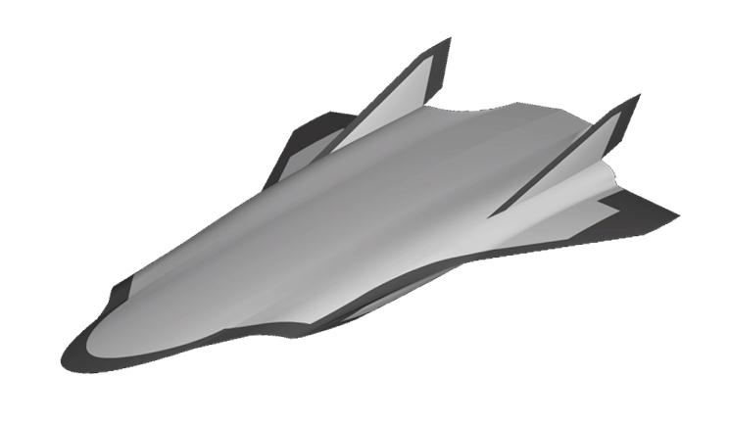
Turbojet – Ramjet – Scramjet Propulsion
Hypersonic Cruise Vehicle
Turbojet
Integrated Inlet
Ramjet Scramjet
Integrated Nozzle
Inlet Diverter Flap

Slide 18
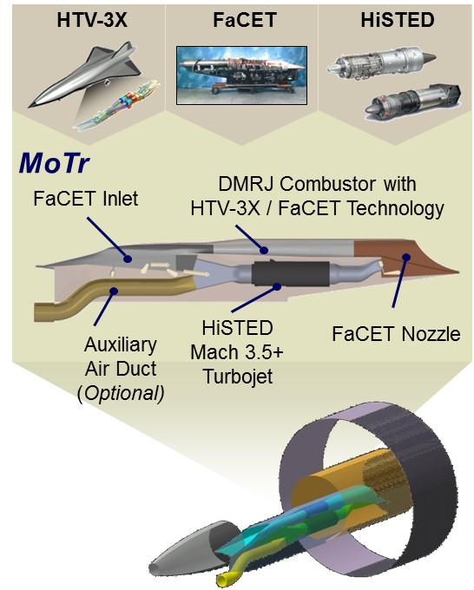
Mode Transition from Turbojet to Ram / Scramjet (MoTr)
Program Goals and Objectives
Ground test an integrated Turbine Based Combined Cycle propulsion system using hydrocarbon fuel to validate the transition from turbojet to ramjet/scramjet in a hypersonic propulsion system
Technical Approach
Complete current FaCET and HiSTED testing
Design TBCC model leveraging DARPA investments in hypersonics:
HTV-3X: configuration
HiSTED: Mach 3.5+ turbine engine
FaCET: propulsion flowpath & ramjet/scram
Select test facility and modify to meet demonstration objectives
Complete TBCC mode transition test
Military Utility
Hypersonic systems offer the opportunity of a disruptive technology to support national security objectives including ISR, strike, and access to space
Successful completion of this ground test is critical to enabling unassisted, air-breathing hypersonic flight

Slide 19
Content
Hypersonic Domain
Rocket Power
Air Breathing
Air Breather Examples
Reusable Air Breather
Concluding Remarks

Slide 20
March Toward Hypersonic Capability
Analysis &
Ground Test
Flight Test
– Air Launch
– Rocket Boost
Powered
T/O, Flight,
& Land
Operational
Capability
TECHNOLOGY READINESS → UTILITY

